Slide 1
Automated Diagnosis of Skin Lesions
Presented by:
Shalu Rani (012565046),
Nasrajan Jalin (013784420),
Krishna Sai Siva Bojja(012435592)

Slide 2
Introduction
Skin Lesions - One of the Primary indicators of Skin Cancer
More people are diagnosed in US with skin cancer compared to all other cancers combined.
1 in 5 Americans develop skin cancer by the age of 70
Early diagnosis is important
We attempt to classify Skin lesions into 7 categories
Our model gives 3 most probable diagnosis

Slide 3
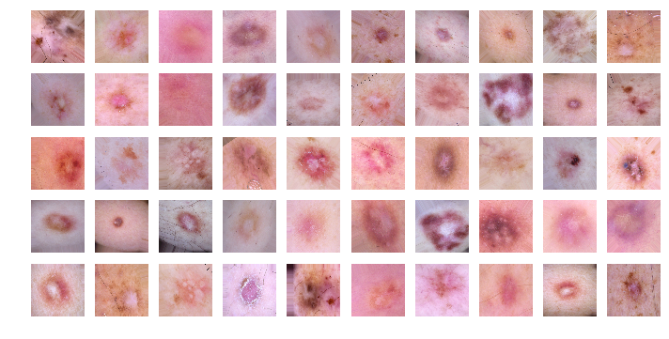
About Data
Medical Image Data
MNIST HAM10000 (Humans Against Machines)
10015 images
Following 7 classes :
Melanocytic nevi (nv) , Melanoma(mel), Benign keratosis-like lesions(bkl), Basal cell carcinoma (bcc), Actinic keratoses (akiec), Vascular lesions(vasc), Dermatofibroma (df)

Slide 4
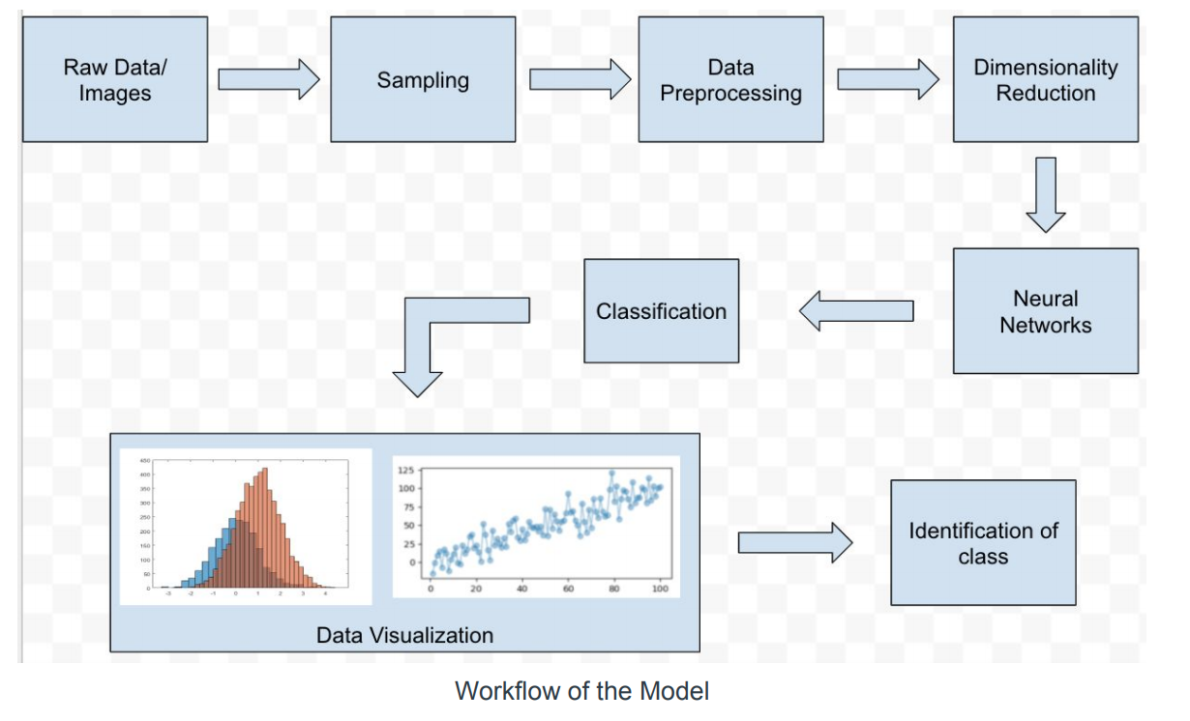
Strategy

Slide 5
Data Preprocessing
Dimensionality Reduction
Reshaping Images
Normalization
Using Mean and Standard Deviation
Resampling

Slide 6
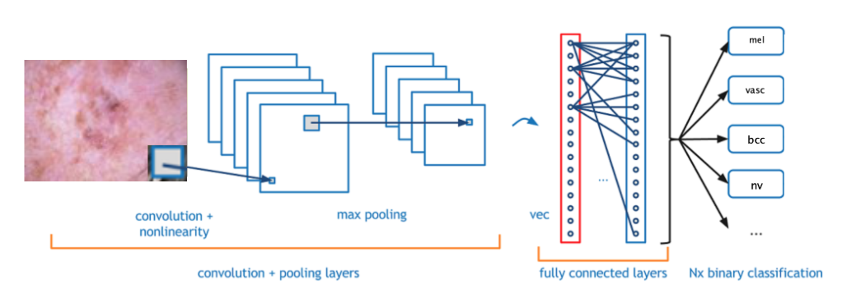
Classifier - CNN
Convolutional Neural network (CNN)
CNN is a class of deep, forward-feed artificial neural networks, most commonly applied to analyzing visual imagery. CNNs use a variation of multilayer perceptrons designed to require minimal preprocessing.
Figure above shows the different layers

Slide 7
Why CNN?
Assumes input to be images
Near accurate classification of images
List of layers that transform the image volume into an output volume
Scalable for large datasets
Efficient feature extraction from images

Slide 8
CNN Configuration Parameters
Sequential model
Core layers: dense, convolution, flatten, dropout, pooling
Activation functions
Epochs
Optimizer
Loss
Metrics

Slide 9
Classification
3 types of Samples : unbalanced, 1000 per class, 1500 per class
Number of epochs: 20, 50, 75
Optimizer: Adam, SGD
Layers: 12, 16

Slide 10
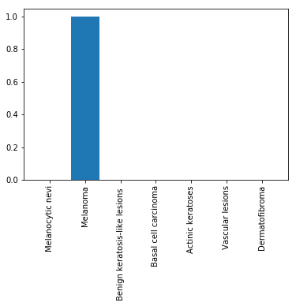
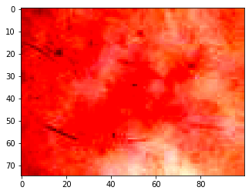
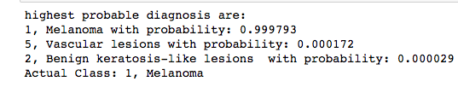
Result -1

Slide 11

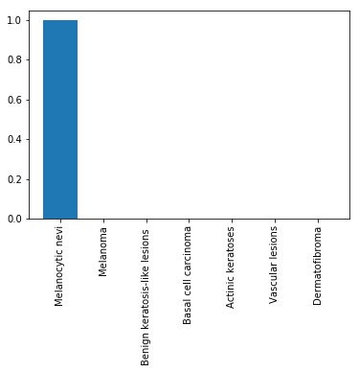
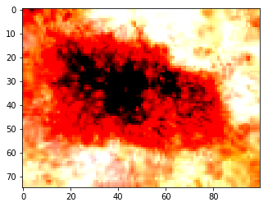
Result -2

Slide 12
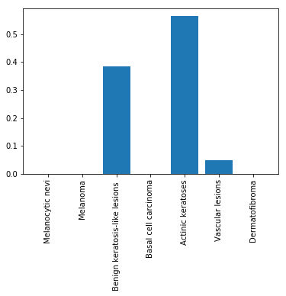

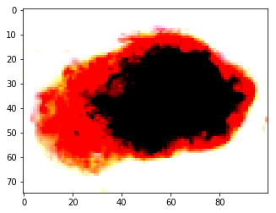
Result -3 (Incorrect)

Slide 13
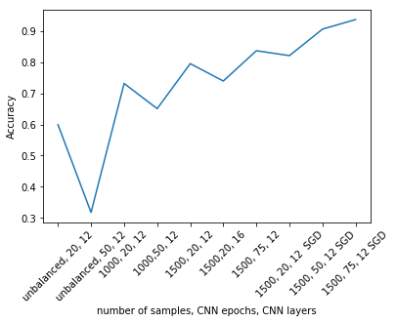
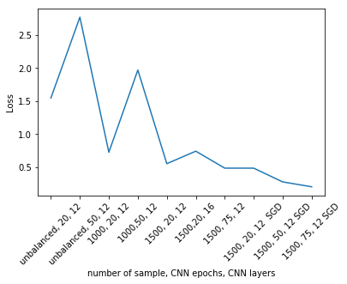
Visualization

Slide 14
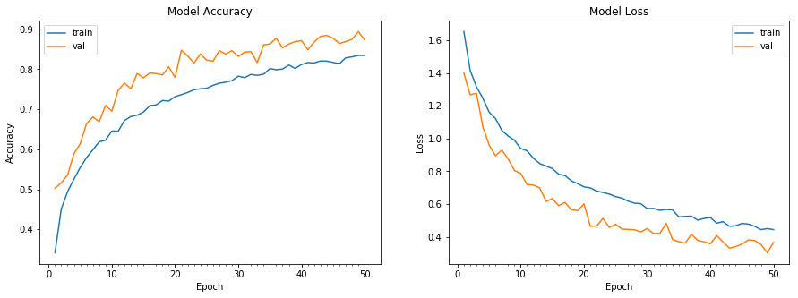
Visualization

Slide 15
Conclusion
Automated Diagnosis of Skin Lesions
Convolutional Neural Network Classifier
Model Accuracy - 0.8852
Test Accuracy - 0.9364
Test Loss - 0.19911

Slide 16

Conclusion
Data science has lot to contribute in medical researches
HAM10000 data is one step towards it
We hope this will trigger productive discussions

Slide 17
References
https://www.kaggle.com/kmader/skin-cancer-mnist-ham10000/version/2
https://dataverse.harvard.edu/dataset.xhtml?persistentId=doi:10.7910/DVN/DBW86T
https://www.skincancer.org/skin-cancer-information/skin-cancer-facts
https://en.wikipedia.org/wiki/Convolutional_neural_network
https://keras.io/optimizers/
http://cs231n.github.io/convolutional-networks/

